Slide 1
WMTS OGC 07-057r7 https://portal.ogc.org/files/?artifact_id=35326
Joan Masó (UAB-CREAF)
12 June 2023

Slide 2


Standard documents in OGC API Maps/Tiles
OGC API Commons Part2…
OGC API Maps Part 1
OGC API Tiles
Part 1
OGC 20-057
OGC API Commons Part 1
OGC 19-072
Ready to OAB+RFC
Two Dimensional Tile Matrix Set
OGC 17-083r2
Common Tile Matrix Set
In the Definition Servers
Core tiling conceptual and logical model
OGC 19-014r1

Slide 3
Standard documents in WMTS
OGC WMTS Simple profile
OGC 13-082r2
OGC WMTS
OGC 07-057r7

Slide 4
Limiting flexibility: No Bbox!
Discrete regular division, limited number of scales: 3 indices x,y,z
Constant tile size (at least in a tilematrix
Tile indices (TileCol,TileRow)
Coarse resolution. Highest scale denominator
TopLeftCorner
0,0
1,0
...
MatrixWidth-1,0
x,y
z
0,1
1,1
...
MatrixWidth-1,1
...
...
...
...
0, Matrix‌Height-1
1, Matrix‌Height-1
...
...
Tile Height
Detailed resolution. Lowest scale denominator
TileWidth
TileMatrixSet
TileMatrix
Notes:
Substitute the BoundingBox by 3 indexes

Slide 5
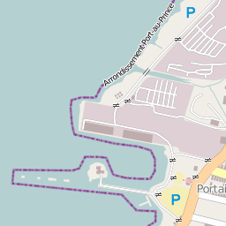
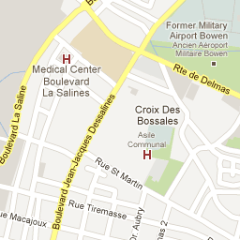
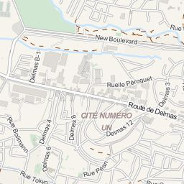
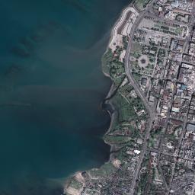
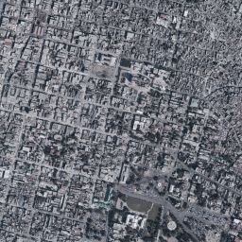
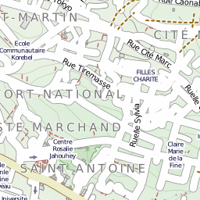
Tile Example TileMatrix ID=15
a.tile.openstreetmap.org
mt1.google.com
otile1.mqcdn.com/tiles/1.0.0/map
X=9798
Y=14664
X=9799
Y=14664
X=9800
Y=14664
www.ogc.uab.cat/SITiled/GeoEye_Haiti_M
tile.opencyclemap.org/cycle
X=9798
Y=14665
X=9799
Y=14665
X=9800
Y=14665
ecn.t0.tiles.virtualearth.net
Notes:
http://a.tile.openstreetmap.org/15/9798/14664.png
http://mt1.google.com/vt/hl=en&z=15&y=14664&x=9799
http://www.ogc.uab.cat/SITiled/GeoEye_Haiti_M/GeoEye/WorldSphericalMercator/15/9798/14665.jpg
http://ecn.t0.tiles.virtualearth.net/tiles/a032211203002113.jpeg?g=854
http://otile1.mqcdn.com/tiles/1.0.0/map/15//9800/14664.png
http://tile.opencyclemap.org/cycle/15/9800/14665.png
(http://maptile.maps.svc.ovi.com/maptiler/maptile/newest/normal.day/15/9800/14665/256/png8)

Slide 6
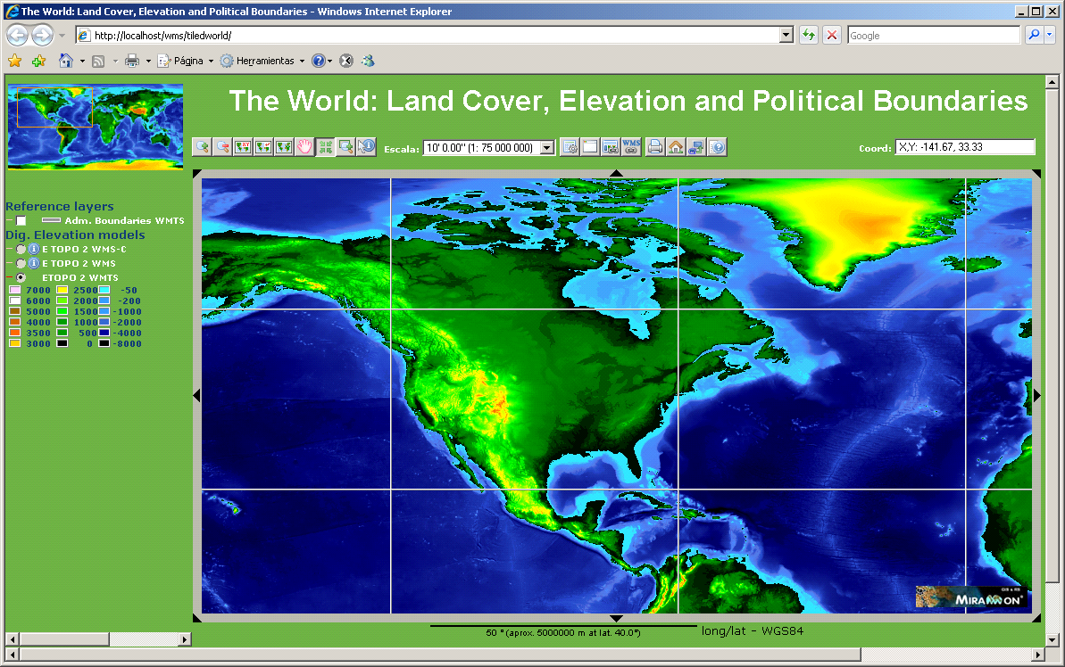
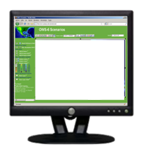

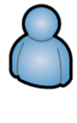

More concurrent but more controlled
Tile requests:
http://server/10m/0/0.png
http://server/10m/0/1.png
http://server/10m/0/2.png
http://server/10m/0/3.png
http://server/10m/1/0.png
http://server/10m/1/1.png
http://server/10m/1/2.png
http://server/10m/1/3.png
http://server/10m/2/0.png
http://server/10m/2/1.png
http://server/10m/2/2.png
http://server/10m/2/3.png
This is a tile
Notes:
.

Slide 7
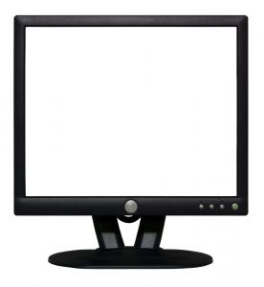
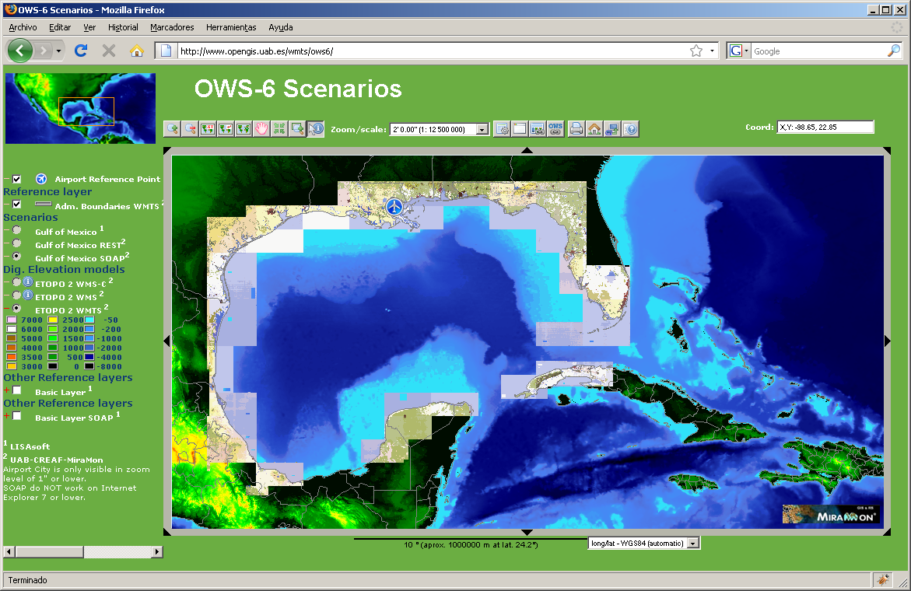
WMTS client and server implementation interaction
Client divides the view in tiles that will be presented one next to the other.
Determining the tile index of the view (JavaScript)
ITileMin = floor((MinX - TopLeftCorner.x) / (PixelWidth*TileWidth))
ITileMax = floor((MaxX - TopLeftCorner.x) / (PixelWidth*TileWidth))
JTileMin = floor((TopLeftCorner.y - MaxY) / (PixelHeight*TileHeight))
JTileMax = floor((TopLeftCorner.y - MinY) / (PixelHeight*TileHeight))
//Determining the offset form the origin of the view
//of the first tile (in pixels)
dx= floor((MinX - (TopLeftCostat.x + PixelWidth*TileWidth*ITileMin)) / PixelWidth)
dy= floor(((TopLeftCorner.y - PixelHeight*TileHeight*JTileMin) - MaxY) / PixelHeight)

Slide 8
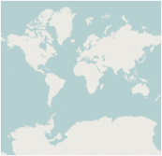
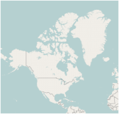
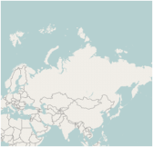
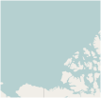
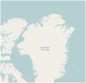
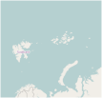
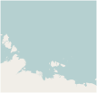
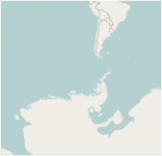
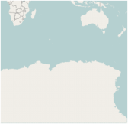
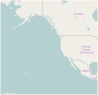
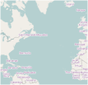
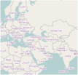
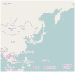
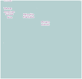
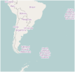
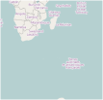
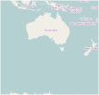
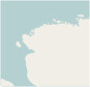
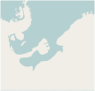
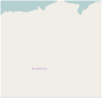
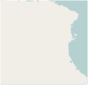
WMTS in brief
3 resources/operations
ServiceMetadata document (GetCapabilities)
List of Layers
List of TileMatrixSets
Themes classification
Tile (GetTile)
FeatureInfo document (GetFeatureInfo)
3 bindings
KVP (service oriented)
SOAP (service oriented)
RESTful URL (resource oriented)
Well Known Scale Sets
GoogleMapsCompatible
GlobalCRS84Scale, GlobalCRS84Pixel ...
Notes:
.

Slide 9
KVP in WMTS
GetTile
www.maps.cat/maps.cgi?service=WMTS&request=GetTile& version=1.0.0&layer=coastlines&time=2007-06& style=darkBlue&TileMatrixSet=Matrix84& TileMatrix=5e6&TileCol=112&TileRow=42&format=image/png
GetFeatureInfo
www.maps.cat/maps.cgi?service=WMTS&request=GetFeatureInfo& version=1.0.0&layer=coastlines&time=2007-06& style=darkBlue&TileMatrixSet=Matrixz84&TileMatrix=5e6& TileCol=112&TileRow=42&&J=23I=35&InfoFormat=text/xml

Slide 10
RESTful request
The client will execute a "template processor“ with a template that finds in the layer description in the GetCapabilities
<ResourceURL format="image/png" resourceType="tile" template="http://www.opengis.uab.es/SITiled/world/etopo2/default/WholeWorld_CRS_84/{TileMatrix}/{TileRow}/{TileCol}.png"/>
<ResourceURL format="text/xml" resourceType="FeatureInfo" template="http://www.opengis.uab.es/SITiled/world/etopo2/default/WholeWorld_CRS_84/{TileMatrix}/{TileRow}/{TileCol}/{J}/{I}.xml"/>
Notes:
This client illustrates the 3 kinds of requests KVP, RESTFul and SOAP.
The client has been based on a preexisting WMS client form MiraMon project that has been programmed only in JavaScript.

Slide 11
RESTful request
… and get the actual URL
<ResourceURL format="image/png" resourceType="tile" template="http://www.opengis.uab.es/SITiled/world/etopo2/default/WholeWorld_CRS_84/1:25000/32/24.png"/>
<ResourceURL format="text/xml" resourceType="FeatureInfo" template="http://www.opengis.uab.es/SITiled/world/etopo2/default/WholeWorld_CRS_84/1:25000/32/24/200/168.xml"/>
Notes:
This client illustrates the 3 kinds of requests KVP, RESTFul and SOAP.
The client has been based on a preexisting WMS client form MiraMon project that has been programmed only in JavaScript.

Slide 12
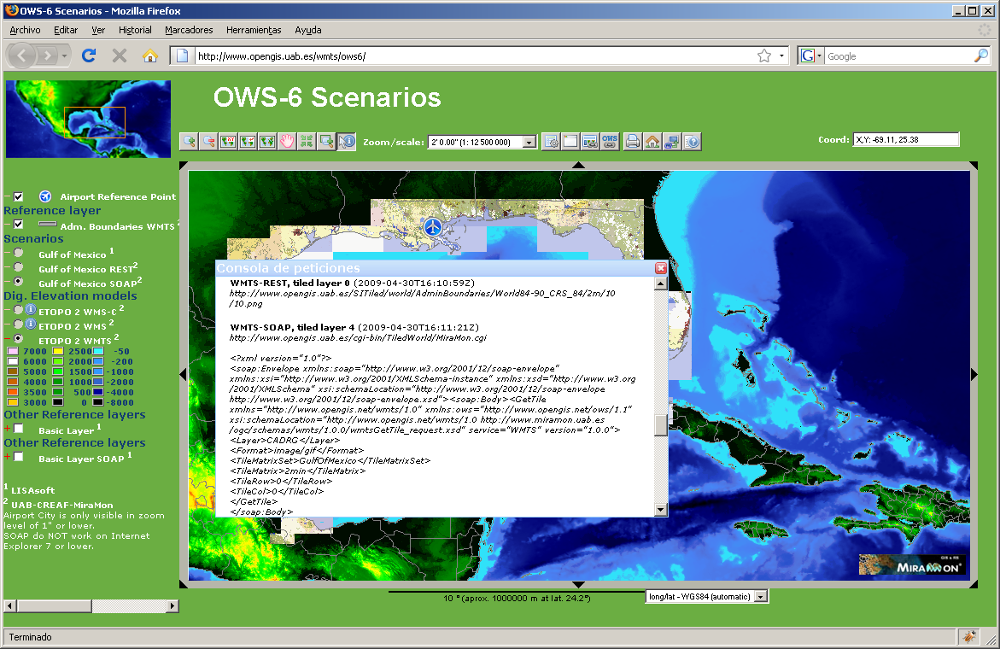
SOAP request (OWS-6 ER)
Notes:
This client illustrates the 3 kinds of requests KVP, RESTFul and SOAP.
The client has been based on a preexisting WMS client form MiraMon project that has been programmed only in JavaScript.

Slide 13
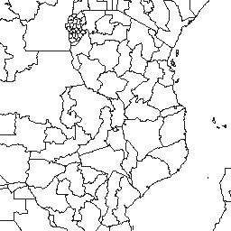
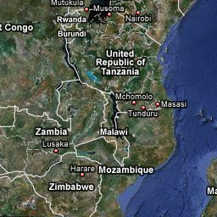
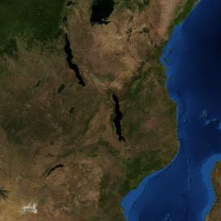
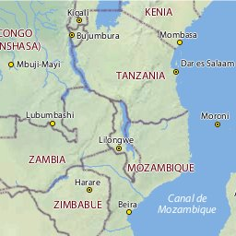
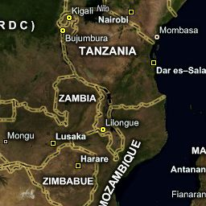
KVP, RESTful and SOAP: GetTile request
KVP
www.maps.cat/maps.cgi?service=WMTS&request=GetTile& version=1.0.0&layer=coastlines&time=2007-06& style=darkBlue&TileMatrixSet=Matrix84& TileMatrix=5e6&TileCol=112&TileRow=42&format=image/png
REST
www.maps.cat/tiledWorld/coastlines/ 2007-06/darkBlue/matrix84/5e6/42/112.png
SOAP
<?xml version="1.0" encoding="UTF-8"?>
<soap:Envelope xmlns:soap="http://www.w3.org/2001/12/soap-envelope">
<soap:Body>
<GetTile service="WMTS" version="1.0.0" xmlns="http://www.opengis.net/wmts/1.0">
<Layer>coastlines</Layer>
<Dimension name="time">2007-06</Dimension>
<Style>darkBlue</Style>
<Format>image/png</Format>
<TileMatrixSet> Matrix84</TileMatrixSet>
<TileMatrix>10m</TileMatrix>
<TileRow>42</TileRow>
<TileCol>112</TileCol>
</GetTile>
</soap:Body>
</soap:Envelope>

Slide 14
WellKnownScaleSet versus TileMatrixSet
Well Know Scale Sets:
Define a common CRS
Dedine a common list of scales
Tile Matrix Set
Define a CRS
Define a list of scales (zooms)
For each scale
Define the origin of the tiles
Define the size of the tiles and how many.
The assumption was:
Interpolating between scales in the client results in “blurry” images. We do not want that!
Visualize tilesets with different origin is solved by a shift. No problemo!.
No need for common TileMatrixSets but only fixed sets of scales?
With time, a small set of TileMatrixSets became popular and the idea of WKSS was proved as wrong

Slide 15
WMTS Simple
OGC 13-082r2
https://docs.ogc.org/is/13-082r2/13-082r2.html

Slide 16
The concept: Use just TWO TileMatrixSet that are completely predefined.
Google mercator
CRS84
CRS:
EPSG::3857
Single origin:
-20037508.3427892 20037508.3427892
TileMatrix id’s:
0,1,2,3,4,5,6,7...
TileMatrixSet scales
TileMatrix 0 covers the world
(almost)
Powers of 2.
CRS:
CRS:84
Single origin:
-180.0,90.0
TileMatrix id’s:
0,1,2,3,4,5,6,7...
TileMatrixSet scales
TileMatrix 0 covers the world
Powers of 2.

Slide 17
WMTS simple requirements (1/2)
1
It follows WMTS 1.0 (no modifications needed)
2
Ows:profile=
http://www.opengis.net/spec/wmts-simple/1.0/conf/simple-profile
http://www.opengis.net/spec/wmts-simple/1.0/conf/simple-profile/CRS84
3
Use REST
4
ServiceMetadata not mandatory but if exists the URL follows
[http://www.server.bob/path]/1.0.0/WMTSCapabilities.xml
5
Default style with blank name

Slide 18
WMTS simple requirements (2/2)
6
Mandatory tile URL template
[http://www.server.bob/path]{/layer}{/TileMatrixSet}/{TileMatrix}/{TileCol}/{TileRow}{.file_extension}
7
GoogleMercator TileMatrixSet has to be supported
8
If http://www.opengis.net/spec/wmts-simple/1.0/conf/simple-profile/CRS84
Then also CRS84 TileMatrixSet has to be supported

Slide 19
WMTS simple benefits
Benefits
TileMatrixSet can be hardcoded in the implementation
No need to read the ServiceMetadata document
Tile indices always corresponds to the same place
Shorter URLs
Follow the same rules that e.g. OSM
Do I have to cover the whole world?
No: Use TileMatrixSetLimits to advertise your tiles ranges limits

Slide 20
Service Metadata Example
<Capabilities>
<ows:Title>UAB-CREAF-MiraMon OWS-9 WMTS test demostration</ows:Title>
<ows:Profile>http://www.opengis.net/spec/wmts-simple/1.0/conf/simple-profile</ows:Profile>
<Layer>
<TileMatrixSetLink>
<TileMatrixSet>WorldSphericalMercator</TileMatrixSet>
<TileMatrixSetLimits>
<TileMatrixLimits>
<TileMatrix>15</TileMatrix>
<MinTileRow>14659</MinTileRow>
<MaxTileRow>14672</MaxTileRow>
<MinTileCol>9791</MinTileCol>
<MaxTileCol>9809</MaxTileCol>
</TileMatrixLimits>
</TileMatrixSetLimits>
</TileMatrixSetLink>
<ResourceURL format="image/jpeg" resourceType="tile" template="http://www.ogc.uab.es/SITiled/GeoEye_Haiti_M/{TileMatrixSet}/{TileMatrix}/{TileCol}/{TileRow}.jpg"/>
</Layer>
<TileMatrixSet>
<ows:Title>TileMatrixSet per Haiti_WMTS</ows:Title>
<ows:Identifier>WorldSphericalMercator</ows:Identifier>
<WellKnownScaleSet>urn:ogc:def:wkss:OGC:1.0:GoogleMapsCompatible</WellKnownScaleSet>
<TileMatrix>
<ows:Identifier>15</ows:Identifier>
<ScaleDenominator>17061.83667080</ScaleDenominator>
<TopLeftCorner>-20037508.3427892 20037508.3427892</TopLeftCorner>
<TileWidth>256</TileWidth>
<TileHeight>256</TileHeight>
<MatrixWidth>32768</MatrixWidth>
<MatrixHeight>32768</MatrixHeight>
</TileMatrix>
</TileMatrixSet>
<ServiceMetadataURL xlink:href="http://www.ogc.uab.es/SITiled/GeoEye_Haiti_M/1.0.0/WMTSCapabilities.xml"/>
</Capabilities>

Slide 21
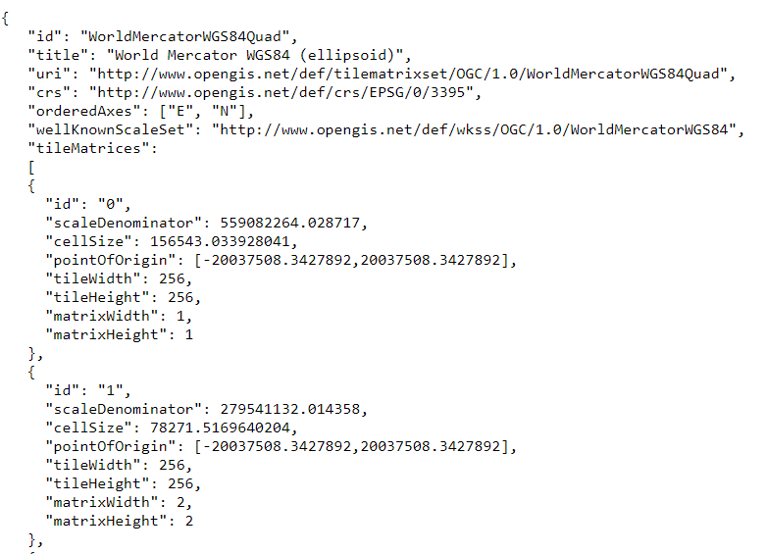
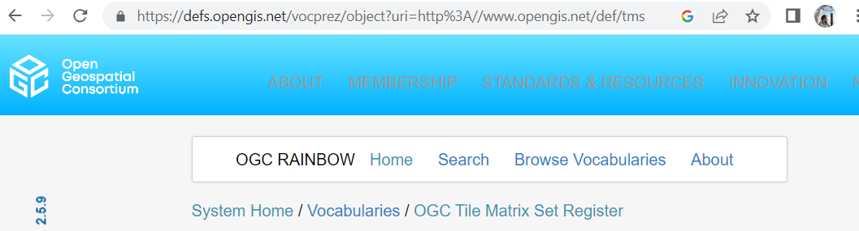
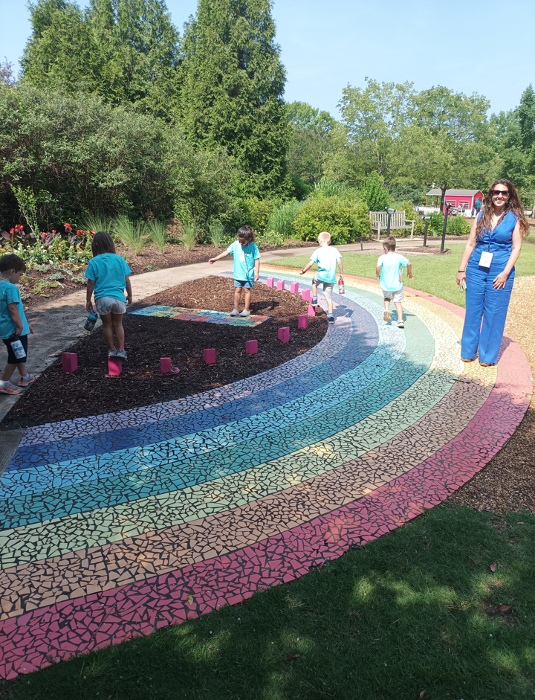
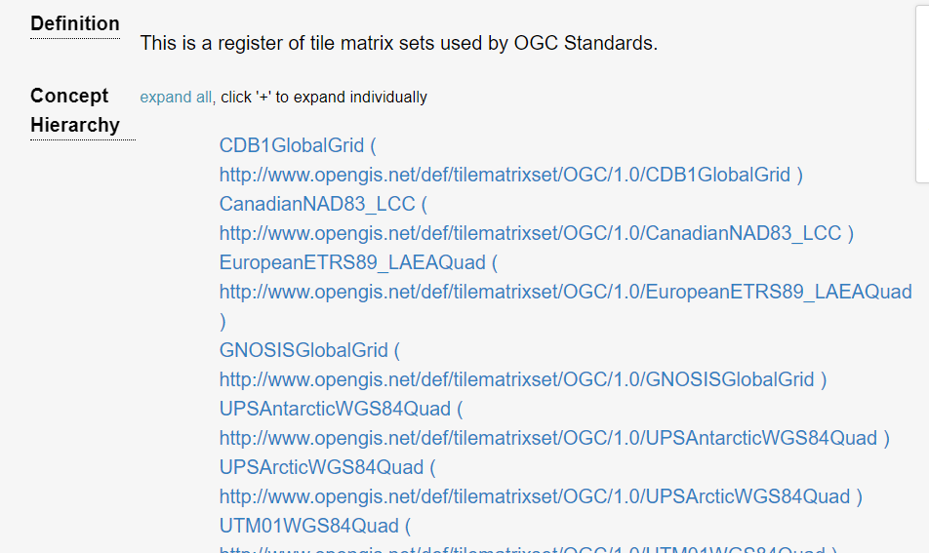
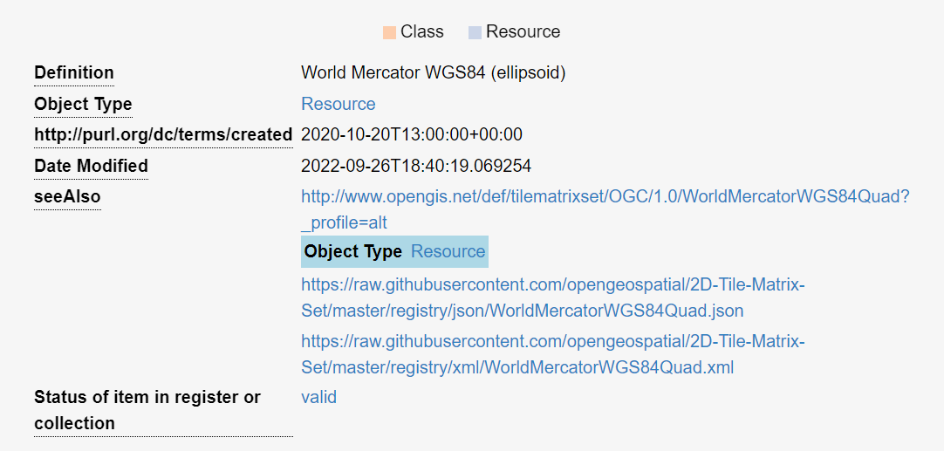
List of TileMatrixSets in the OGC Definition Server

Slide 22
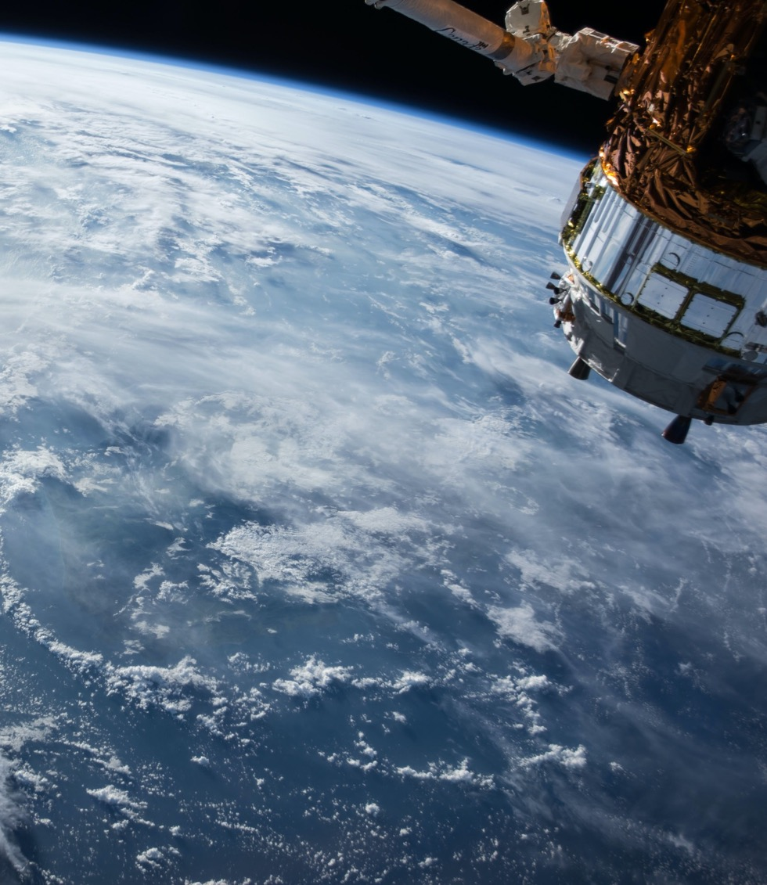
Thank You
Community

